Slide 1
Digital Image Processing
Submitted by:
SHILPA JOY
S5 MCA

Slide 2
Content
What is Image Processing ?
Applications
Purpose of Image Processing
Components of Image Processing
Types of Image Processing
Digital image and Digital Image Processing
History of DIP
Advantages
Disadvantages
Conclusion

Slide 3
What is Image Processing
An image is nothing more than a two dimensional signal. It is defined by the mathematical function f(x,y) where x and y are the two co-ordinates horizontally and vertically.
The value of f(x,y) at any point gives the pixel value at that point of an image.
Image Processing is any form of signal processing for which our input is an image, such as photographs or frames of video and our output can be either an image or a set of characteristics or parameters related to the image.
A digital image is an array of real or complex numbers represented by a finite number of bits.
The optical and analog image processing is also possible.

Slide 4
Applications
Face detection
Feature detection
Non-photorealistic rendering
Medical image processing
Microscope image processing
Morphological image processing
Remote sensing
Finger print recognition

Slide 5
Components of Image Processing
Image Sensors
Image Displays
Software(CImg, OpenCV)
Image Processing Hardware
Memory

Slide 6
Purpose of Image Processing
Visualization - Observe the objects that are not visible.
Image sharpening and restoration - To create a better image.
Image retrieval - Seek for the image of interest.
Measurement of pattern – Measures various objects in an image.
Image Recognition – Distinguish the objects in an image.

Slide 7
Types
Analog Image Processing
Digital Image Processing
Optical Image Processing

Slide 8
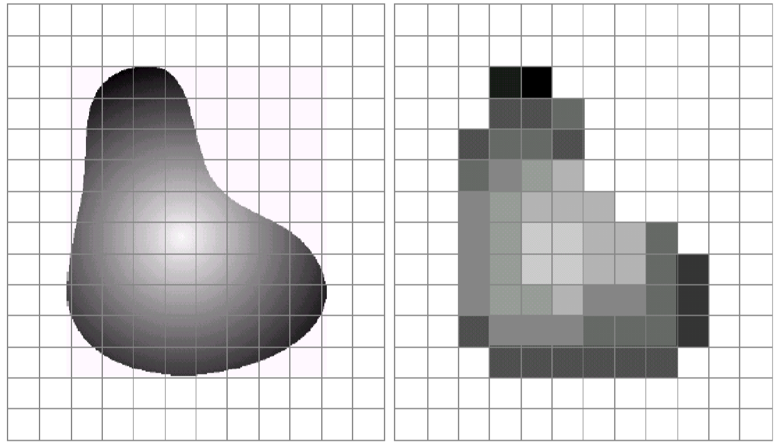
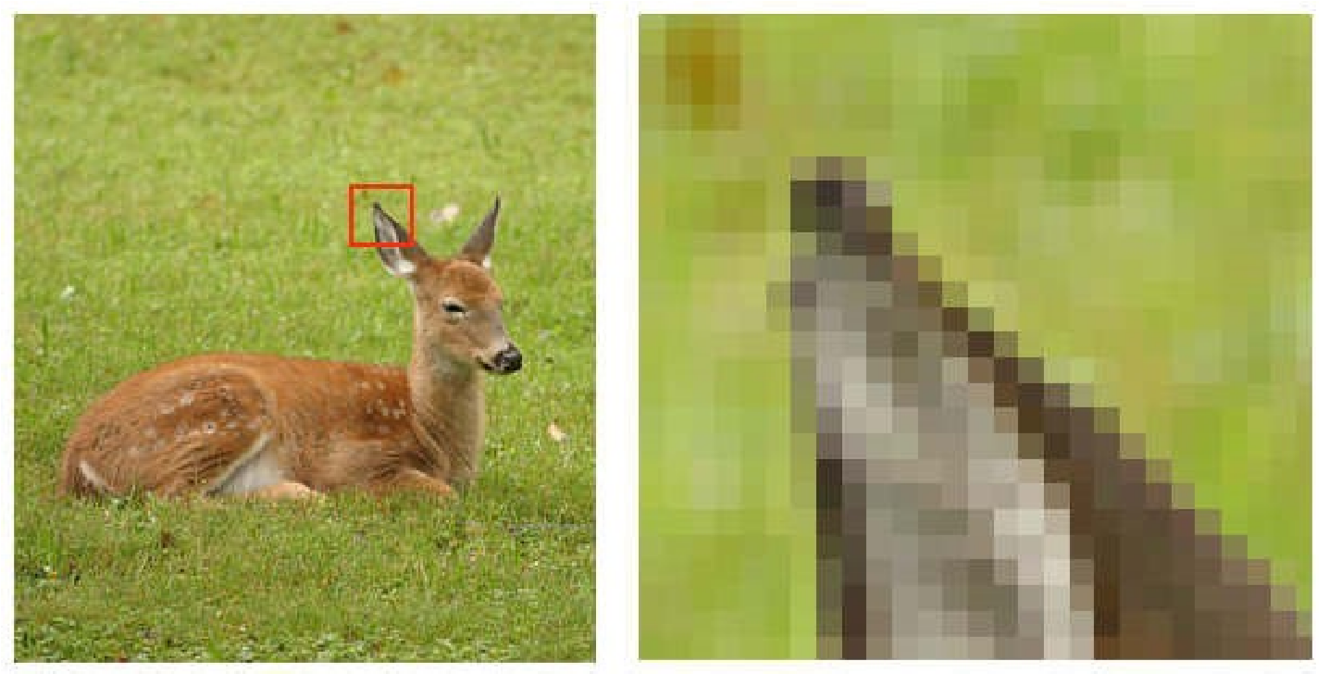
Digital Image
Digital image is composed of finite number of elements
Elements – Picture Elements, Image Elements, Pels or Pixels
Pixel is used to denote the elements of a digital image.
1
pixel

Slide 9
Digital Image Processing(DIP)
Digital Image Processing deals with images which are two-dimensional entities (such as scanned office documents, x-ray films, satellite pictures, etc.) captured electronically through a scanner or camera system that digitizes the spatially continuous coordinates to a sequence of 0’s and 1’s.

Slide 10
Digital image processing is the use of computer algorithms to create, process, communicate, and display digital images. Digital image processing algorithms can be used to:
Convert signals from an image sensor into digital images
Improve clarity, and remove noise and other artifacts
Extract the size, scale, or number of objects in a scene
Prepare images for display or printing
Compress images for communication across a network

Slide 11


The following images illustrate a few of these examples:
Removing noise using a Wiener Filter.
Counting circular objects in an image.

Slide 12
History of DIP
Early 1920s: One of the first applications of digital imaging was in the newspaper industry
The Bartlane cable picture transmission service
Images were transferred by submarine cable between London and New York
Pictures were coded for cable transfer and reconstructed at the receiving end

Slide 13
1960s: Improvements in computing technology and the onset of the space race led to a surge of work in digital image processing
1964: Computers used to improve the quality of images of the moon taken by the Ranger 7 probe
1970s: Digital image processing begins to be used in medical applications
Tomography (CAT) scans
Used in the detection of tumors or for screening the patients

Slide 14
1980s - Today: The use of digital image processing techniques has exploded and they are now used for all kinds of tasks in all kinds of areas
Image enhancement/restoration
Artistic effects
Medical visualisation
Industrial inspection
Law enforcement
Human computer interfaces

Slide 15
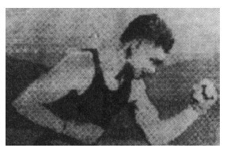
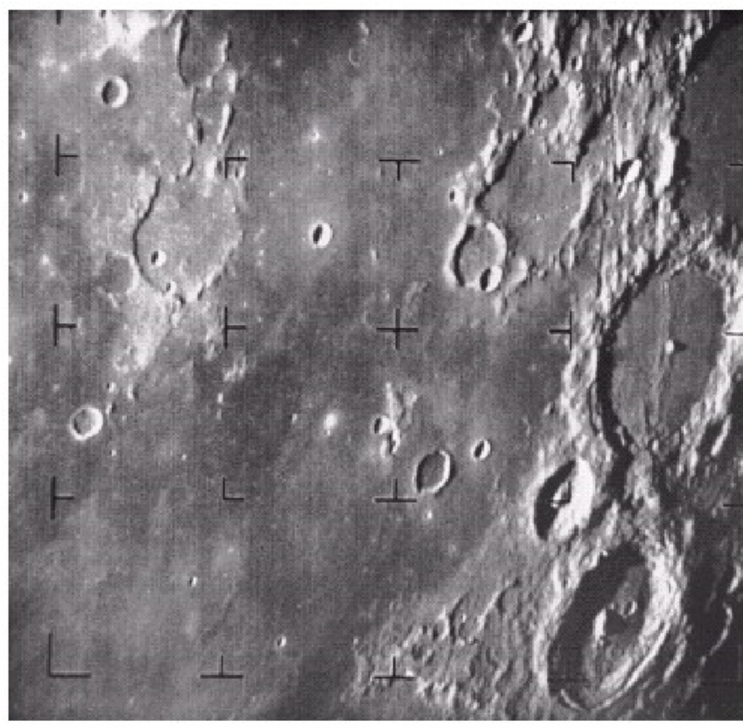
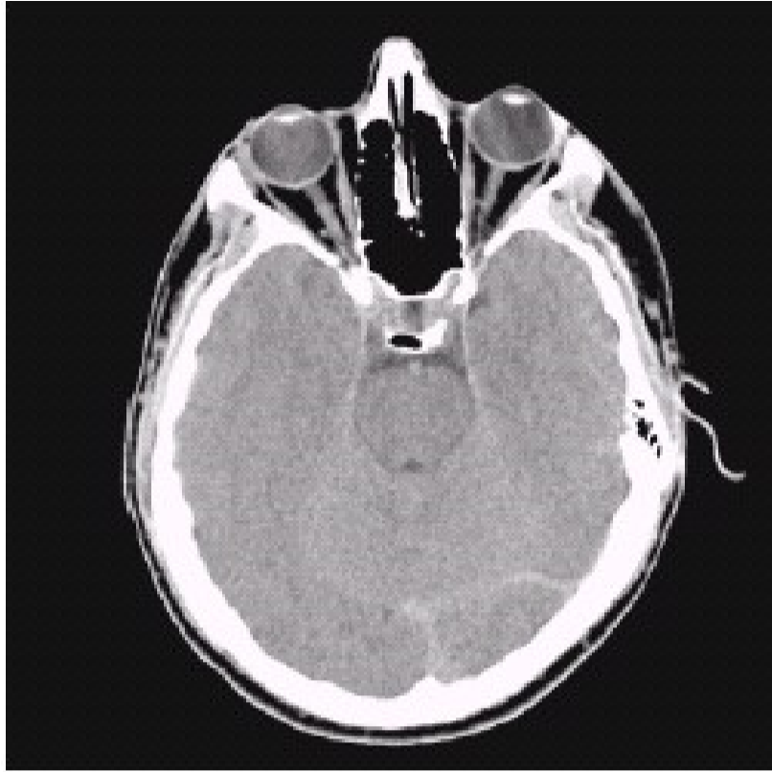
Early digital image
A picture of the moon taken by the Ranger
7 probe minutes before landing
Typical head slice CAT image

Slide 16
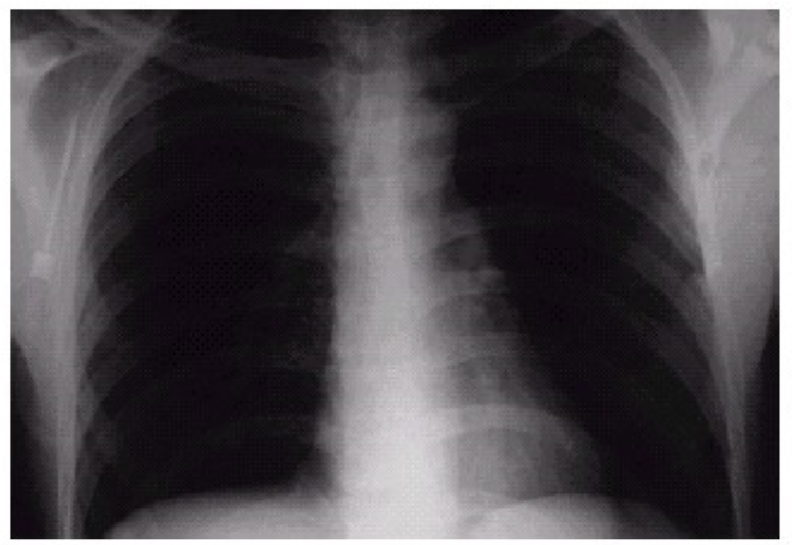
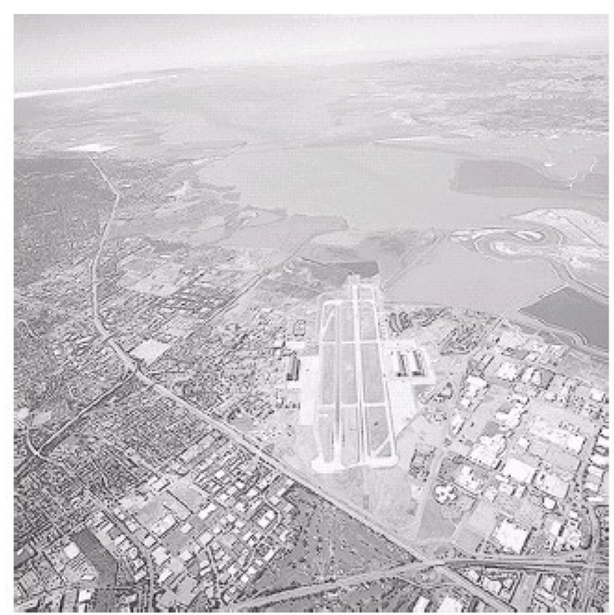
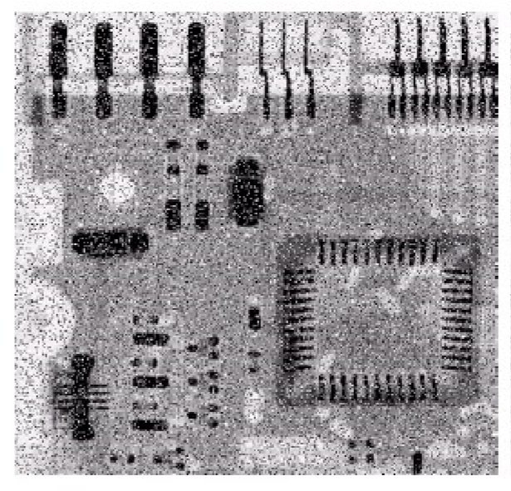
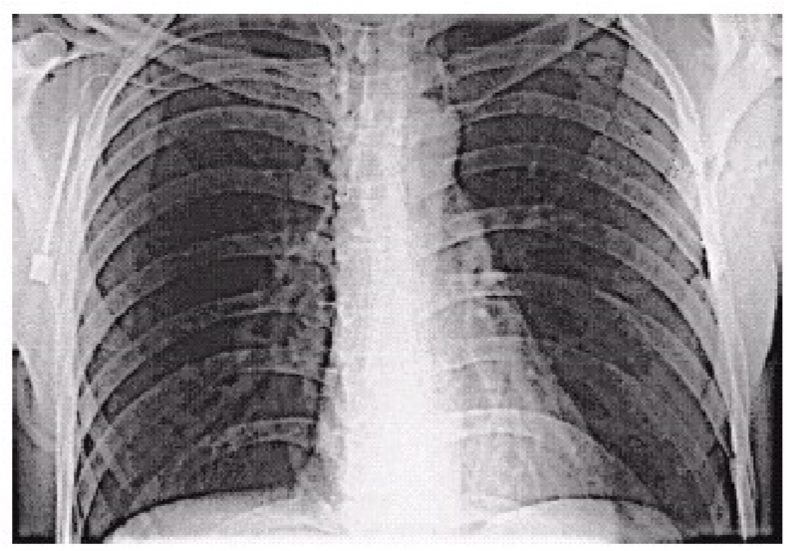
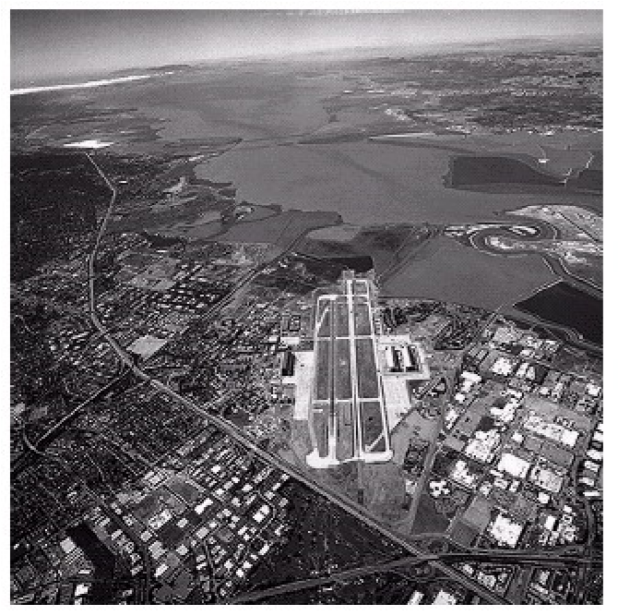
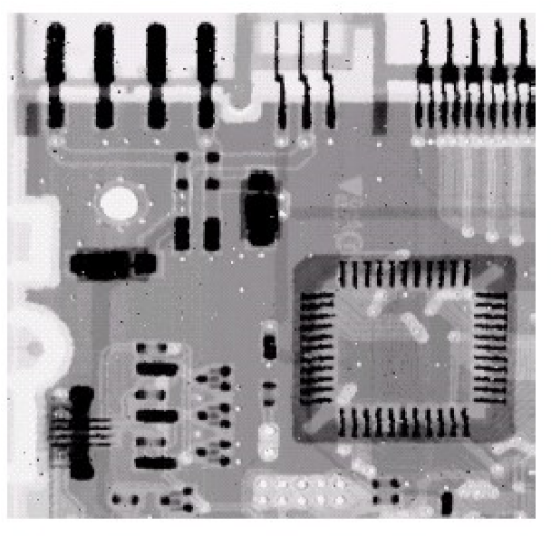
IMAGE ENHANCEMENT

Slide 17
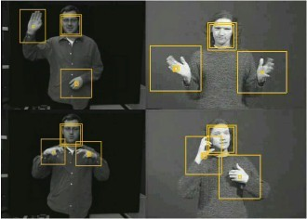
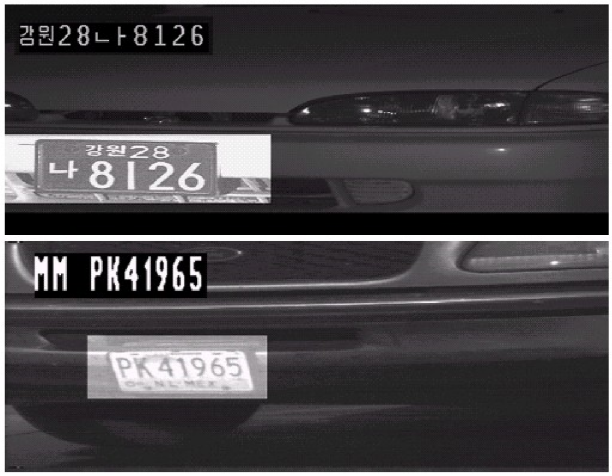
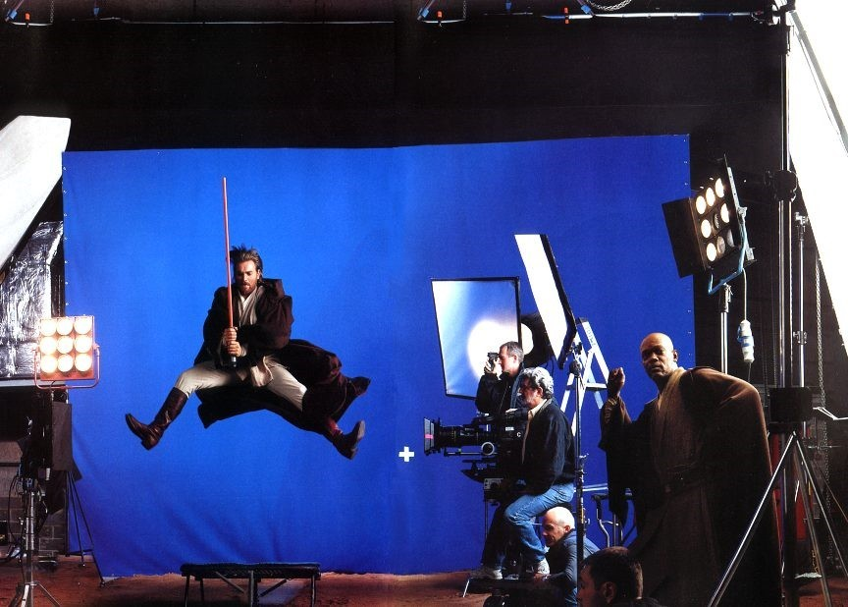
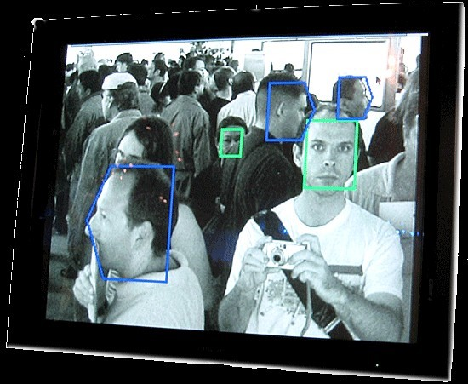
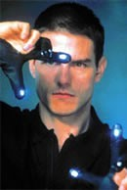
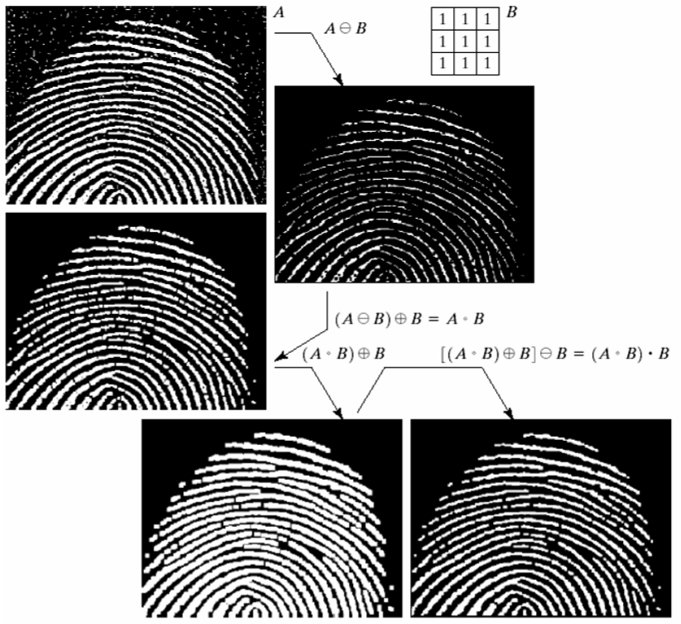
Artistic effects are used to make images more visually appealing to add special effects and to make composite images
Human computer interfaces(HCI)
Face recognition
Gesture recognition
Law enforcers
Number plate recognition for speed cameras/automated toll systems
Fingerprint recognition

Slide 18
Advantages
Digital images can be processed by digital computers.
Important features such as edges can be extracted from images which can be used in industry.
Images can be given more sharpness and better visual appearance.
Minor errors can be rectified.
It allows robots to have vision.
It allows weather forecasting.
It is used to analyse medical images.

Slide 19
Disadvantages
The initial cost can be high depending on the system used, the number of detectors purchased, etc.
Time consuming.
Lack of qualified professional.
Expensive for one-time or just few times user.

Slide 20
Conclusion
It’s a critical study, which plays a vital role in modern world as it is involved with advanced use of science and technology.
The advances in technology have created tremendous opportunities for Vision System and Image Processing. There is no doubt that the trend will continue into the future.
Over the next few years, the growth of digital image processing is going to be enormous with new products and technologies coming out frequently.

Slide 21
THANK YOU

